Slide 1
Recurrent Neural Network(RNN)
Dr. Jayaraj P B
Associate Professor, CSED
NIT Calicut

Slide 2

Modelling Series
In many situations one must consider a series
of inputs to produce an output
– Outputs too may be a series
Examples: Stock Market Prediction, Language Translation etc.

Slide 3

The stock prediction problem…
To invest or not to invest?
stocks
7/03 8/03 9/03 10/03 11/03 12/03 13/03 14/03 15/03
Stock market
Must consider the series of stock values in the past several days to decide if it is wise to invest today
Ideally consider all of history

Slide 4
The stock predictor network
Y(t+3)
Window
Stock vector
X(t)
X(t+1)
X(t+2)
X(t+3)
X(t+4)
X(t+5)
X(t+6)
X(t+7)
Time
The sliding predictor
Look at the last few days
This is just a convolutional neural net applied to series data
Also called a Time-Delay neural network

Slide 5

Finite-response model
Y(T+3)
Stock vector
X(T-3) X(T-2)
X(T-1) X(T) X(T+1) X(T+2) X(T+3) X(T+4)
Time
Something that happens today only affects the output of the system for days into the future
– Predictions consider N days of history
Markov Assumption
Problem: Increasing the “history” makes the network more complex

Slide 6
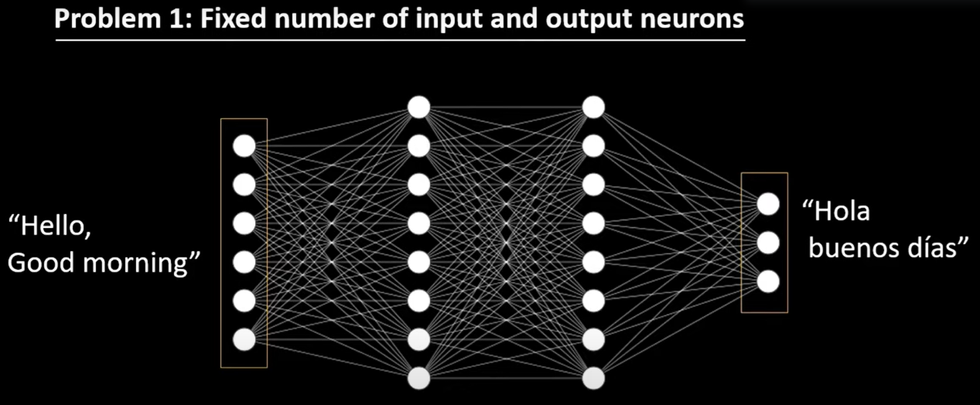
Problems of Deep Neural Nets

Slide 7
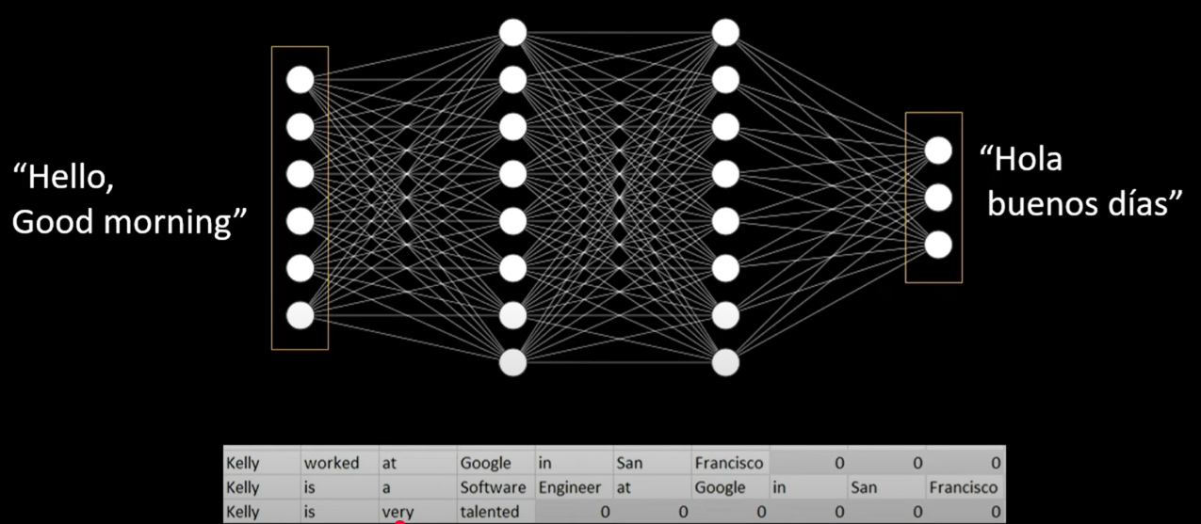
Notes:
We can create the input layer to match the longest sentence size so if sentences are smaller then places where we do not have sufficient words we replace with 0.

Slide 8
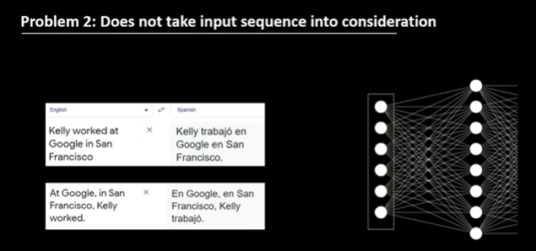
Notes:
We won’t take input sequence into consideration here i.e the positions information about words is no where encoded.

Slide 9
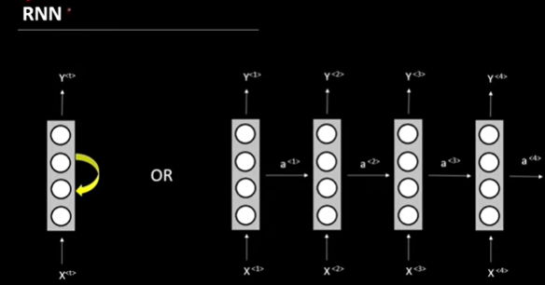
Notes:
In most typical RNN applications for text, the number of time steps is indeed the same as the number of words (or tokens) in the input sequence.
1 timestep is nothing but one iteration of rnn’s recurrence.

Slide 10
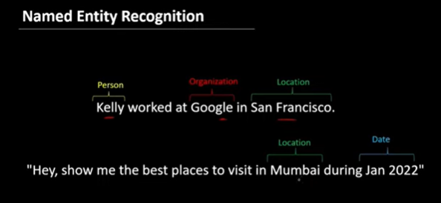
Notes:
Named Entity Recognition
For each word in a sentence, the model predicts a label (like PERSON, LOCATION, ORGANIZATION, etc.).
We use RNN because it will help us understand the context.

Slide 11
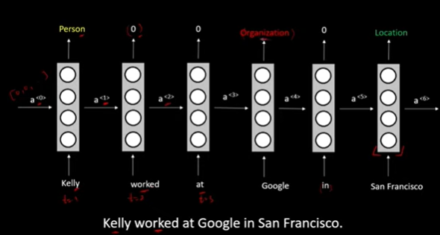
Notes:
For example, to correctly tag “Washington”:
If it follows “Mr.” → likely PERSON
If it follows “in” → likely LOCATION
We can also Bi-RNN in case we might require Bidirectional Context.
Input sentence → Word embeddings → RNN (or Bi-RNN) → Classifier → Tag for each word

Slide 12
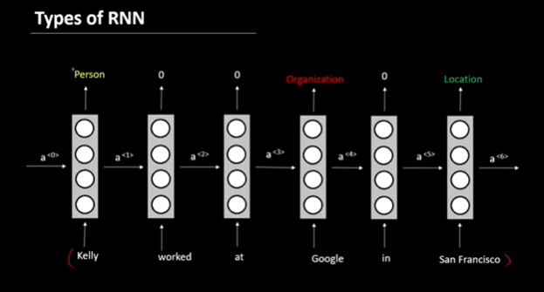
Notes:
RNN can be of several types
Output at every timestep
Ex: Named Entity Recognition, Machine Translation etc.

Slide 13
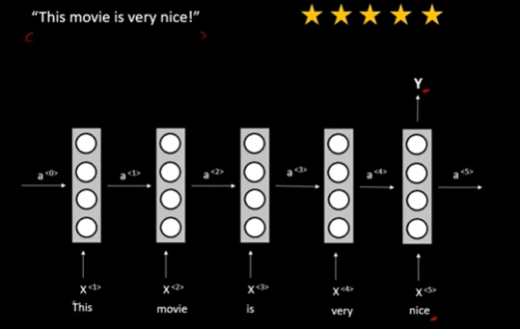
Notes:
2. Output only at last timestep
Ex: Sentiment Analysis

Slide 14
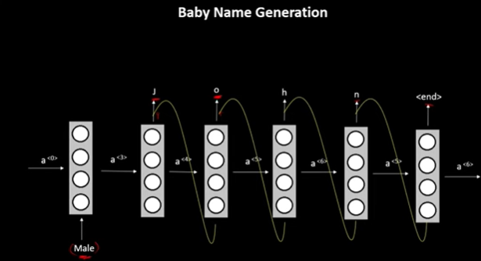
Notes:
The RNN first receives the input that the person is Male based on that the RNN will generate the name of the baby character by character.
(A) Forward pass — prediction/generation
During generation, the RNN moves forward in time.
It takes one input at a time (J → o → h → n → <end>), and the hidden state flows forward
(B) Backward pass — training (error correction)
When training the network, we calculate how far each prediction was from the target.
The error (loss) at the output is propagated backward through time to update the weights — this is called Backpropagation Through Time (BPTT).

Slide 15
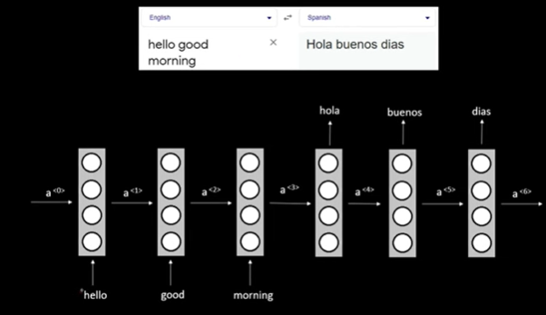
Notes:
4. We can have RNN like Seq2Seq model where in the first layer will be Encoder containing RNN processing unit that creates the embeddings and then we will have the final hidden state as our input to Decoder RNN.
Then decoder RNN will give the output which is machine translated words.

Slide 16
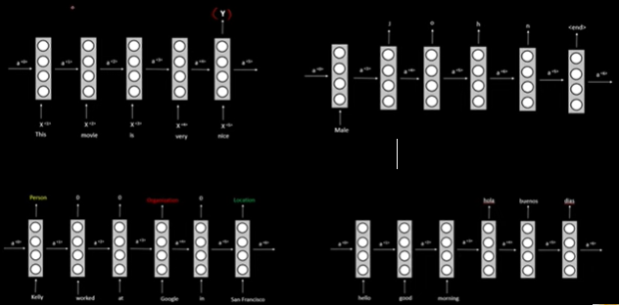

Slide 17
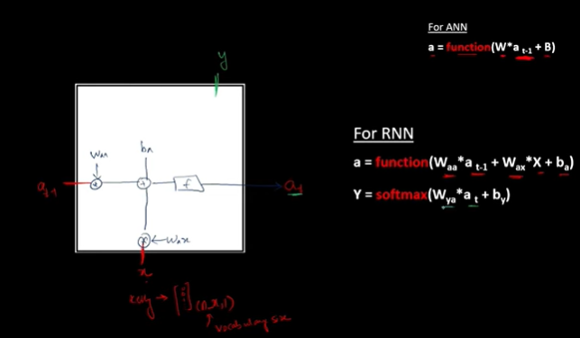

Slide 18
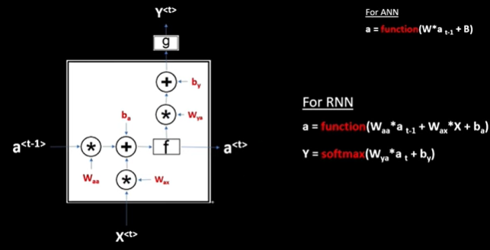

Slide 19
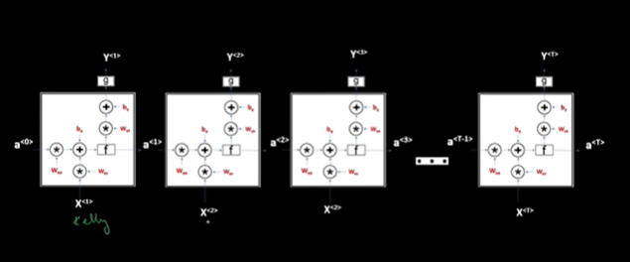

Slide 20
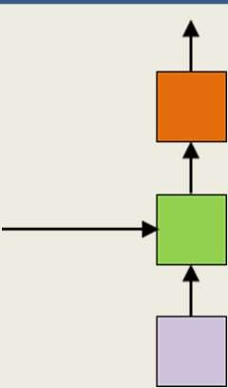
The simple state-space model
t
t–1
t
t
Y(t)
^{h}-1
X(t)
t=0
Time
The state (green) at any time is determined by the input at that time, and the state at the previous time
An input at t=0 affects outputs forever
Also known as a recurrent neural net
51

Slide 21
The detailed version of the simplified representation
Y(t)
^{h}-1
X(t)
t=0
Time
The Transformer Epiphany Speech - Vision - Text Workshop

Slide 22
How do we train the network
Y(0) Y(1) Y(2)
Y(T-2) Y(T-1) Y(T)
^{h}-1
X(0)
X(1)
X(2)
X(T-2)
X(T-1)
X(T)
t
Back propagation through time (BPTT)
Given a collection of sequence inputs
– (𝐗_{i}, 𝐃_{i}), where
– 𝐗_{i} = 𝑋_{i,0}, … , 𝑋_{i,T}
– 𝐃_{i} = 𝐷_{i,0}, … , 𝐷_{i,T}
Train network parameters to minimize the error between the output of the
network _{i i,0 i,T} and the desired outputs
– This is the most generic setting. In other settings we just “remove” some of the input or output entries
The Transformer Epiphany Speech - Vision - Text Workshop

Slide 23
Training the RNN
Y(0)
Y(1)
Y(2)
Y(T-2)
Y(T-1)
Y(T)
^{h}-1
X(0)
X(1)
X(2)
X(T-2)
X(T-1)
X(T)
t
The “unrolled” computation is just a giant shared-parameter neural network
All columns are identical and share parameters
Network parameters can be trained via gradient-descent (or its variants) using shared-parameter gradient descent rules
Gradient computation requires a forward pass, back propagation, and pooling of gradients (for parameter sharing)
The Transformer Epiphany Speech - Vision - Text Workshop

Slide 24
Training: Forward pass
Y(0)
Y(1)
Y(2)
Y(T-2)
Y(T-1)
Y(T)
^{h}-1
X(0)
X(1)
X(2)
X(T-2)
X(T-1)
X(T)
t
For each training input:
Forward pass: pass the entire data sequence through the network, generate outputs

Slide 25
Training: Computing gradients
Y(0)
Y(1)
Y(2)
Y(T-2)
Y(T-1)
Y(T)
^{h}-1
X(0)
X(1)
X(2)
X(T-2)
X(T-1)
X(T)
t
For each training input:
Backward pass: Compute gradients via backpropagation
– Back Propagation Through Time
The Transformer Epiphany Speech - Vision - Text Workshop

Slide 26
Back Propagation Through Time
𝐷𝐼𝑉
𝐷(1. . 𝑇)
𝑌(0)
𝑌(1)
𝑌(2)
𝑌(𝑇 − 2)
𝑌(𝑇 − 1)
𝑌(𝑇)
^{h}-1
𝑋(0) 𝑋(1) 𝑋(2) 𝑋(𝑇 − 2) 𝑋(𝑇 − 1) 𝑋(𝑇)
The divergence computed is between the sequence of outputs
by the network and the desired sequence of outputs
DIV is a scalar function of a series of vectors!

Slide 27
Back Propagation Through Time
𝐷𝐼𝑉
𝐷(1. . 𝑇)
𝑌(0)
𝑌(1)
𝑌(2)
𝑌(𝑇 − 2)
𝑌(𝑇 − 1)
𝑌(𝑇)
^{h}-1
𝑋(0)
𝑋(1)
𝑋(2)
𝑋(𝑇 − 2)
𝑋(𝑇 − 1)
𝑋(𝑇)

Slide 28
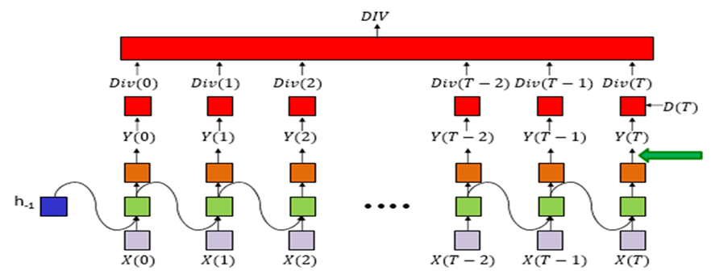

Slide 29
Back Propagation Through Time
𝐷𝐼𝑉
𝐷(1. . 𝑇)
𝑌(0)
𝑌(1)
𝑌(2)
𝑌(𝑇 − 2)
𝑌(𝑇 − 1)
𝑌(𝑇)
^{h}-1
𝑋(0)
𝑋(1)
𝑋(2)
𝑋(𝑇 − 2)
𝑋(𝑇 − 1)
𝑋(𝑇)

Slide 30
Back Propagation Through Time
𝐷𝐼𝑉
𝐷(1. . 𝑇)
𝑌(0)
𝑌(1)
𝑌(2)
𝑌(𝑇 − 2)
𝑌(𝑇 − 1)
𝑌(𝑇)
^{h}-1
𝑋(0)
𝑋(1)
𝑋(2)
𝑋(𝑇 − 2)
𝑋(𝑇 − 1)
𝑋(𝑇)

Slide 31
Back Propagation Through Time
𝐷𝐼𝑉
𝐷(1. . 𝑇)
𝑌(0)
𝑌(1)
𝑌(2)
𝑌(𝑇 − 2)
𝑌(𝑇 − 1)
𝑌(𝑇)
^{h}-1
𝑋(0)
𝑋(1)
𝑋(2)
𝑋(𝑇 − 2)
𝑋(𝑇 − 1)
𝑋(𝑇)

Slide 32
Back Propagation Through Time
𝐷𝐼𝑉
𝐷(1. . 𝑇)
𝑌(0)
𝑌(1)
𝑌(2)
𝑌(𝑇 − 2)
𝑌(𝑇 − 1)
𝑌(𝑇)
^{h}-1
𝑋(0)
𝑋(1)
𝑋(2)
𝑋(𝑇 − 2)
𝑋(𝑇 − 1)
𝑋(𝑇)

Slide 33
Back Propagation Through Time
𝐷𝐼𝑉
𝐷(1. . 𝑇)
𝑌(0)
𝑌(1)
𝑌(2)
𝑌(𝑇 − 2)
𝑌(𝑇 − 1)
𝑌(𝑇)
^{h}-1
𝑋(0)
𝑋(1)
𝑋(2)
𝑋(𝑇 − 2)
𝑋(𝑇 − 1)
𝑋(𝑇)

Slide 34
Back Propagation Through Time
𝐷𝐼𝑉
𝐷(1. . 𝑇)
𝑌(0)
𝑌(1)
𝑌(2)
𝑌(𝑇 − 2)
𝑌(𝑇 − 1)
𝑌(𝑇)
^{h}-1
𝑋(0)
𝑋(1)
𝑋(2)
𝑋(𝑇 − 2)
𝑋(𝑇 − 1)
𝑋(𝑇)

Slide 35
Back Propagation Through Time
𝐷𝐼𝑉
𝐷(1. . 𝑇)
𝑌(0)
𝑌(1)
𝑌(2)
𝑌(𝑇 − 2)
𝑌(𝑇 − 1)
𝑌(𝑇)
^{h}-1
𝑋(0)
𝑋(1)
𝑋(2)
𝑋(𝑇 − 2)
𝑋(𝑇 − 1)
𝑋(𝑇)

Slide 36
Back Propagation Through Time
𝐷𝐼𝑉
𝐷(1. . 𝑇)
𝑌(0)
𝑌(1)
𝑌(2)
𝑌(𝑇 − 2)
𝑌(𝑇 − 1)
𝑌(𝑇)
^{h}-1
𝑋(0)
𝑋(1)
𝑋(2)
𝑋(𝑇 − 2)
𝑋(𝑇 − 1)
𝑋(𝑇)

Slide 37
Back Propagation Through Time
𝐷𝐼𝑉
𝐷(1. . 𝑇)
𝑌(0)
𝑌(1)
𝑌(2)
𝑌(𝑇 − 2)
𝑌(𝑇 − 1)
𝑌(𝑇)
^{h}-1
𝑋(0)
𝑋(1)
𝑋(2)
𝑋(𝑇 − 2)
𝑋(𝑇 − 1)
𝑋(𝑇)
The Transformer Epiphany Speech - Vision - Text Workshop

Slide 38
Back Propagation Through Time
𝐷𝐼𝑉
𝐷(1. . 𝑇)
𝑌(0)
𝑌(1)
𝑌(2)
𝑌(𝑇 − 2)
𝑌(𝑇 − 1)
𝑌(𝑇)
^{h}-1
𝑋(0)
𝑋(1)
𝑋(2)
𝑋(𝑇 − 2)
𝑋(𝑇 − 1)
𝑋(𝑇)

Slide 39
Back Propagation Through Time
𝐷𝐼𝑉
𝐷(1. . 𝑇)
𝑌(0)
𝑌(1)
𝑌(2)
𝑌(𝑇 − 2)
𝑌(𝑇 − 1)
𝑌(𝑇)
^{h}-1
𝑋(0)
𝑋(1)
𝑋(2)
𝑋(𝑇 − 2)
𝑋(𝑇 − 1)
𝑋(𝑇)

Slide 40
Back Propagation Through Time
𝐷𝐼𝑉
𝐷(1. . 𝑇)
𝑌(0)
𝑌(1)
𝑌(2)
𝑌(𝑇 − 2)
𝑌(𝑇 − 1)
𝑌(𝑇)
^{h}-1
𝑋(0) 𝑋(1)
𝑋(2)
𝑋(𝑇 − 2)
𝑋(𝑇 − 1)
𝑋(𝑇)

Slide 41
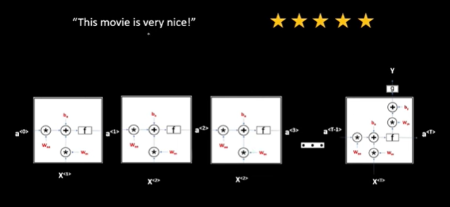

Slide 42
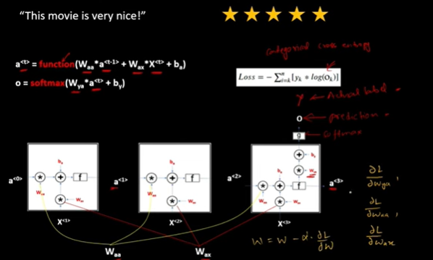

Slide 43
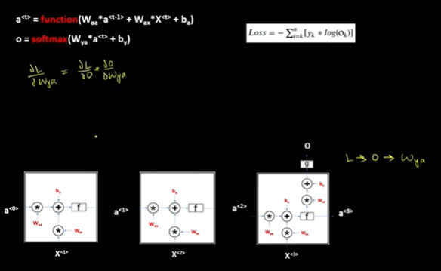

Slide 44
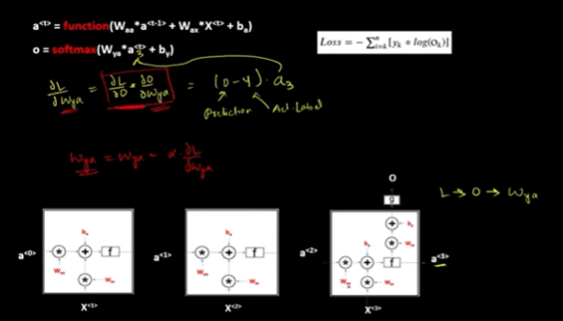

Slide 45
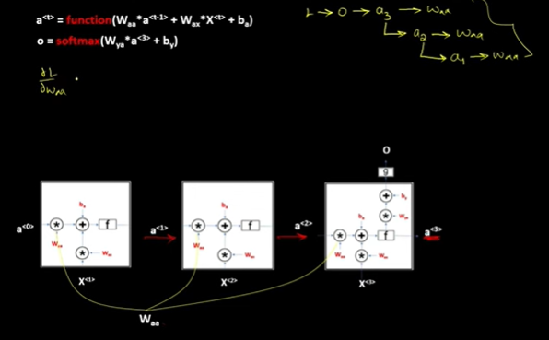

Slide 46
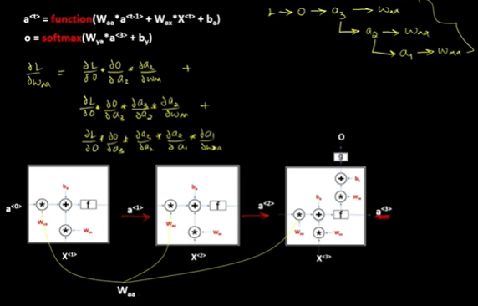

Slide 47
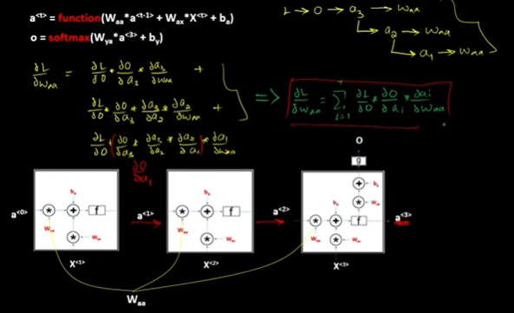

Slide 48
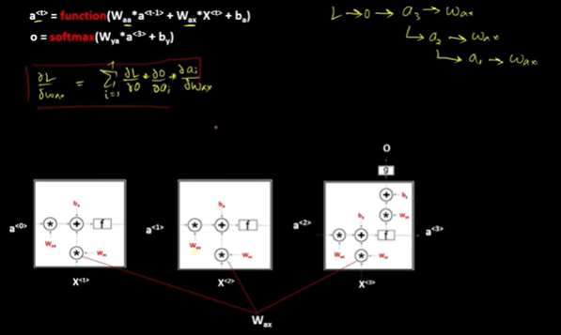

Slide 49
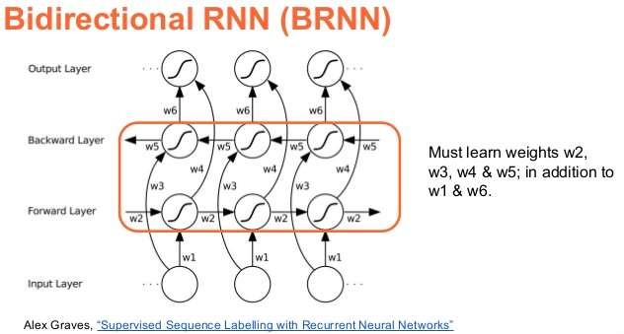
Extensions to the RNN
Proposed by Schuster and Paliwal 1997
RNN with both forward and backward recursion
– Explicitly models the fact that just as the future can be predicted from the past, the past can be deduced from the future

Slide 50

Bidirectional RNN
ℎ(𝑇 − 1)
ℎ(𝑇)
ℎ_{𝑓}(0)
ℎ_{𝑓}(1)
ℎ_{𝑓}(𝑇 − 1)
ℎ_{𝑓}(𝑇)
ℎ_{𝑓}(−1)
ℎ_{𝑏}(0)
ℎ_{𝑏}(1)
ℎ_{𝑏}(𝑇 − 1)
ℎ_{𝑏}(𝑇)
b
𝑋(0) 𝑋(1)
“Block” performs bidirectional inference on input
𝑋(𝑇 − 1)
𝑋(𝑇)
t
– “Input” could be input series X(0)…X(T) or the output of a previous layer (or block)
The Block has two components
A forward net process the data from t=0 to t=T
A backward net processes it backward from t=T down to t=0

Slide 51
The vanishing gradient problem for deep networks
A particular problem with training deep networks..
(Any deep network, not just recurrent nets)
The gradient of the error with respect to weights is unstable..

Slide 52
RNNs..
Excellent models for time-series analysis tasks
Time-series prediction
Time-series classification
Sequence generation..
They can even simplify problems that are difficult for MLPs
But the memory isn’t all that great..
They are very much prone to Vanishing/Exploding Gradients
Long term dependencies are hard to capture
Also they are not parallelizable models
Notes:
Solution to Vanishing Gradient Problem
LSTM
Gated Mechanism i.e GRU
Highway Nets
Skip Connections / Residual Connections
Solution to Exploding Gradients
1. Gradient Clipping

Slide 53
References
https://www.youtube.com/watch?v=BtLJ-oAGvfc
(RNN basics by Prof. Bhiksha Raj, CMU, USA)
http://karpathy.github.io/2015/05/21/rnn-effectiveness/
https://www.youtube.com/watch?v=7ZQgK_MV_t0&list=PLuhqtP7jdD8ARBnzj8SZwNFhwWT89fAFr&index=3

